Slide 1
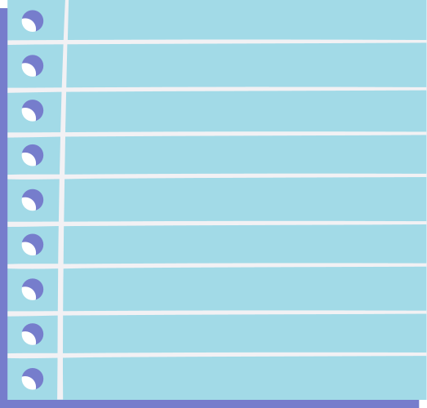





Data Science

Slide 2








WEATHER
Rain
in Australia

Slide 3

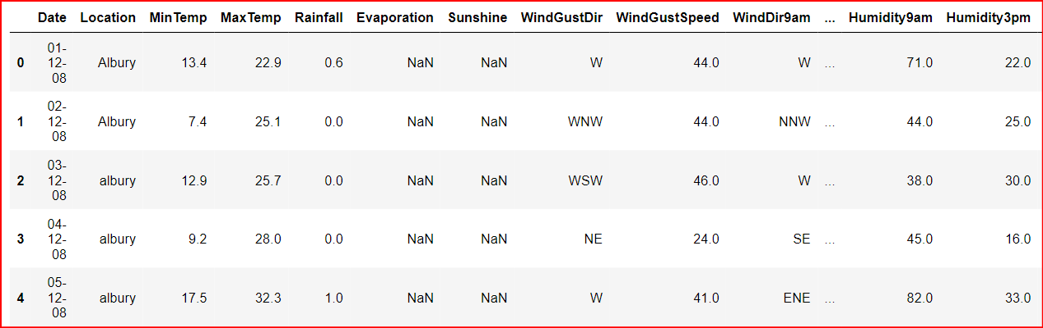


Predict next-day rain in Australia

Slide 4



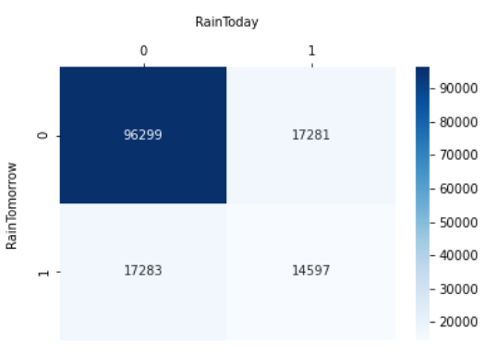


CONFUSION
MATRIX
Question?
IF IT IS RAINING TODAY, WILL IT RAIN TOMORROW ?

Slide 5
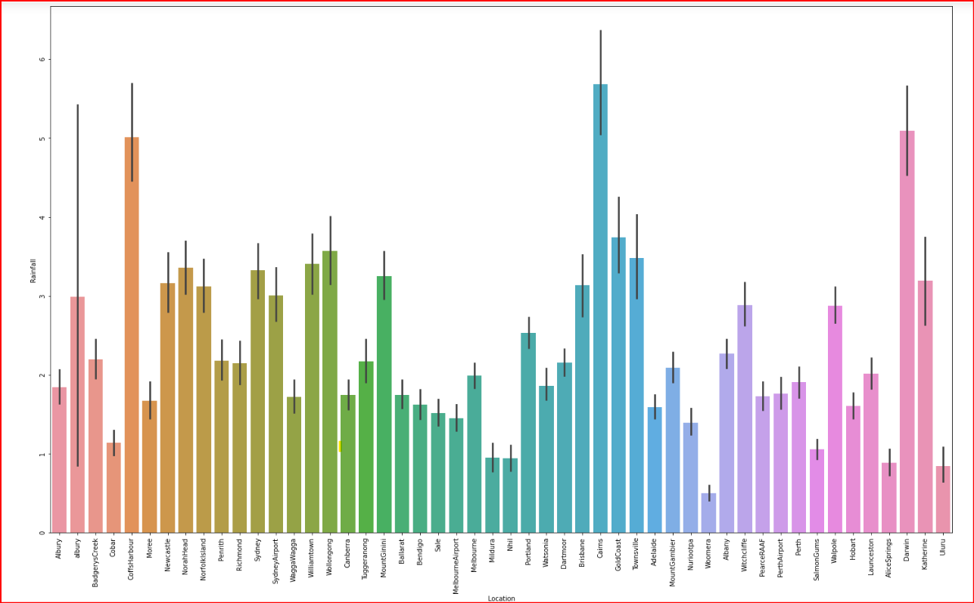






Relationship between Locations & Rainfall

Slide 6
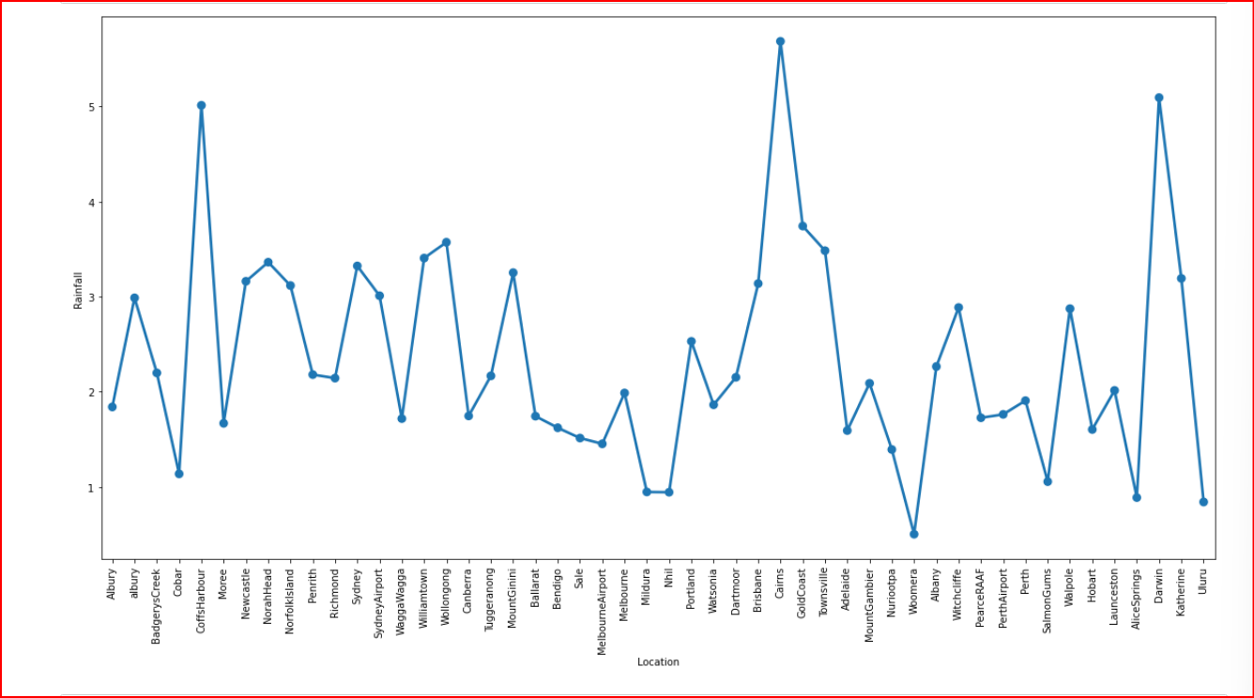
Relationship between Locations & Rainfall

Slide 7
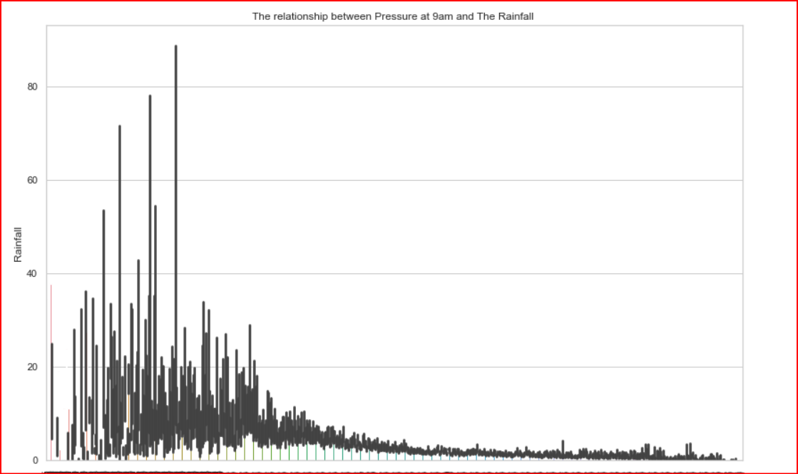
Relationship between Pressure & Rainfall

Slide 8
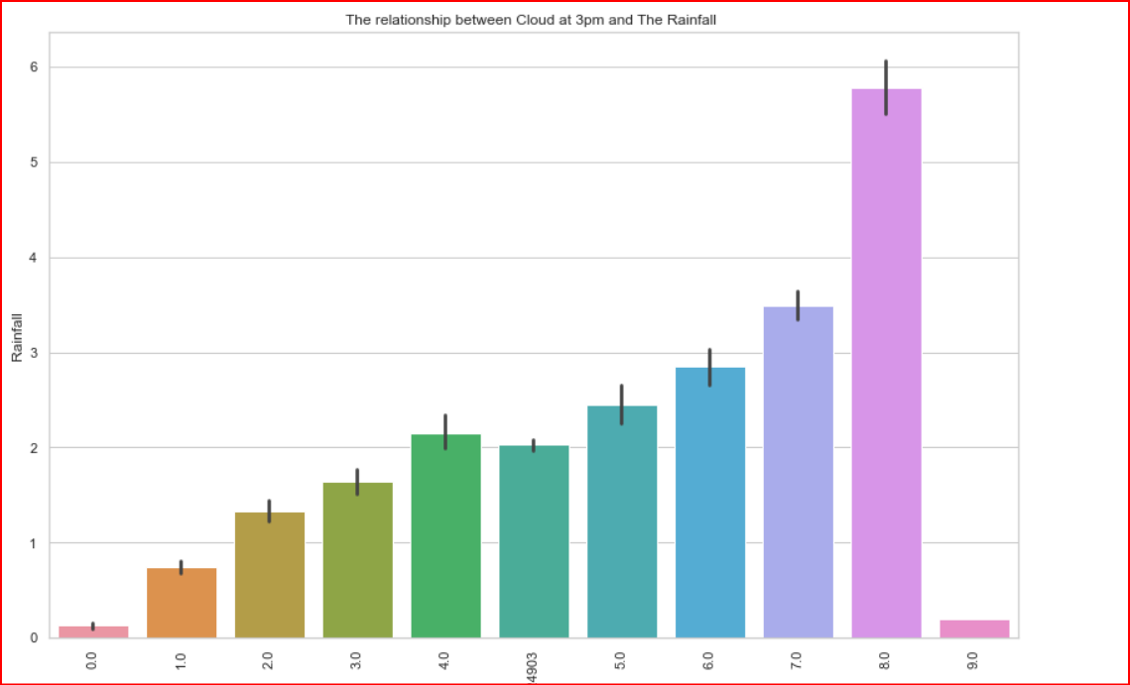
Relationship between Clouds & Rainfall

Slide 9
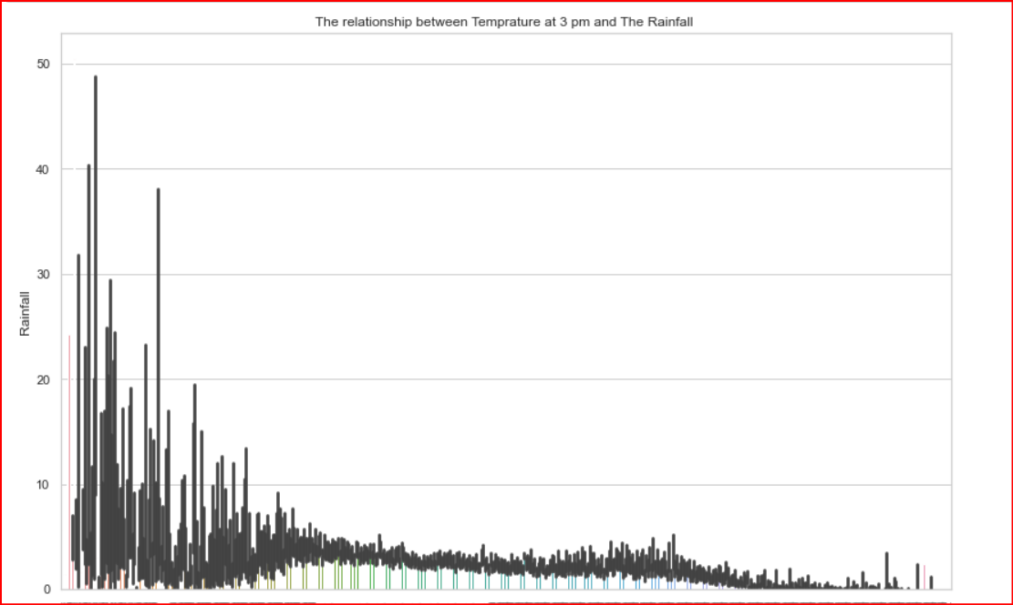
Relationship between Temp & Rainfall

Slide 10






Thank you

